Slide 1


Titolo presentazione sottotitolo
INTERPLANETARY & PLANETARY
EXPLORER MISSION
Milano, XX mese 20XX
Group 2337:
Casiero Alessia 233125
Fiume Elisa 243232
Gallo Emanuele 243222
Marotta Arianna 247719

Slide 2
ASSIGNMENT 1
INTERPLANETARY EXPLORER MISSION
Introduction
Design process
Time Window
Genetic Algorithm
Fmincon Algorithm
Grid Search
Heliocentric Trajectories
Powered Gravity Assist
Conclusions

Slide 3
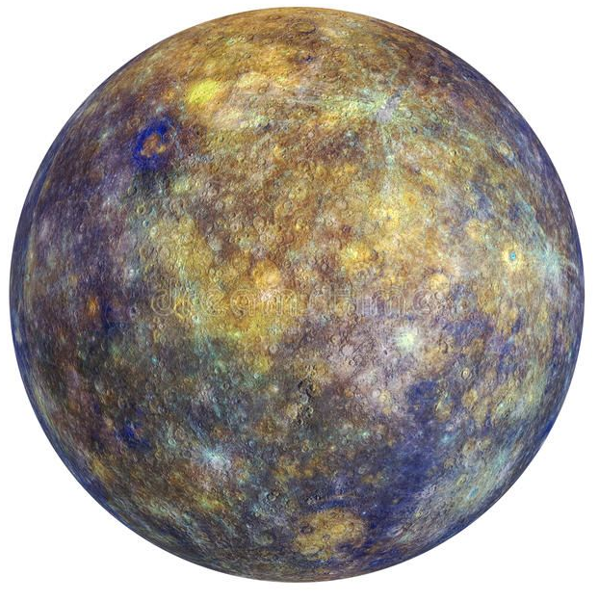
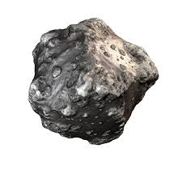
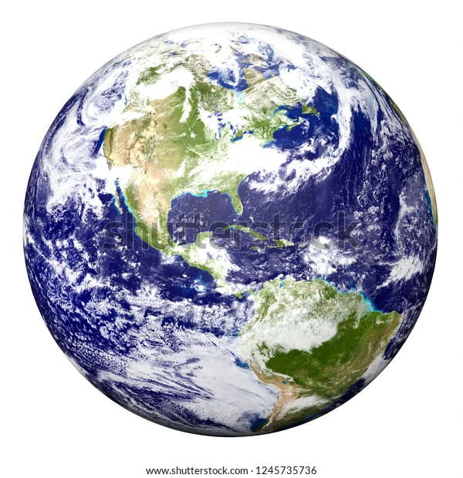
Departure planet: Mercury
Arrival body: Asteroid N.21
Earliest Departure:
01/01/2028
00:00:00
Latest Arrival:
01/01/2058
00:00:00
Fly-By: Earth
Casiero, Fiume, Gallo, Marotta – Group 2337

Slide 4
Workflow
Reasonable
mission
time
Cost minimization
ΔV
Mission goals
Maximum time window:
30 years
Patched conic method
Minima Grid Creation Algorithm
Minimization
Algorithms
Design process
Constraints

Slide 5
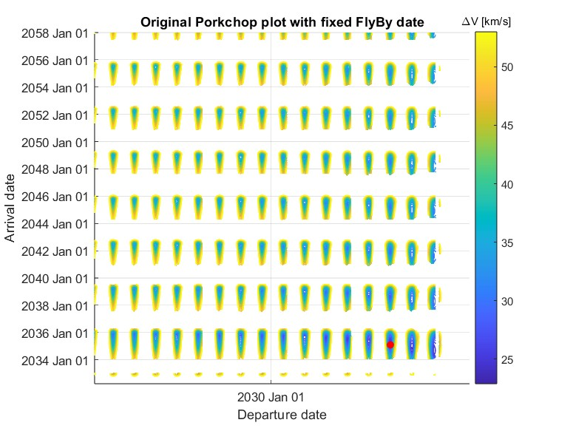
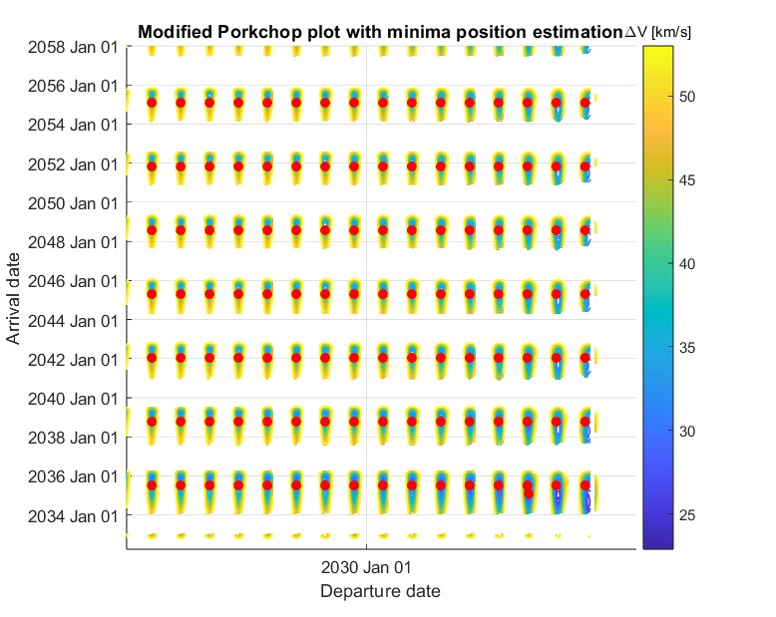
Minima Grid Creation Algorithm

Slide 6
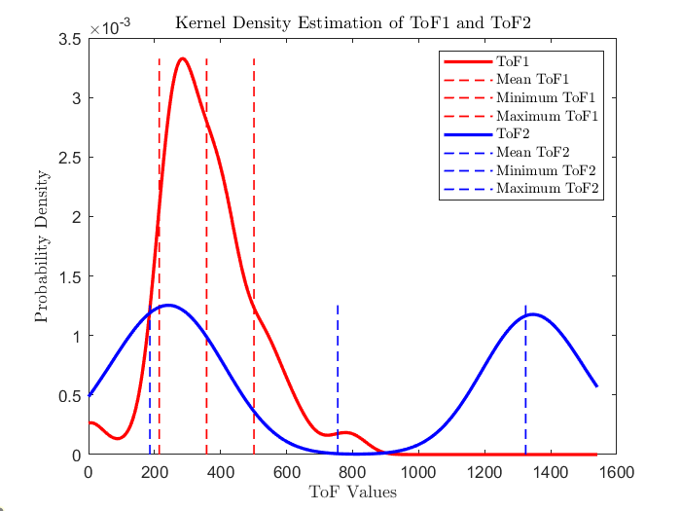
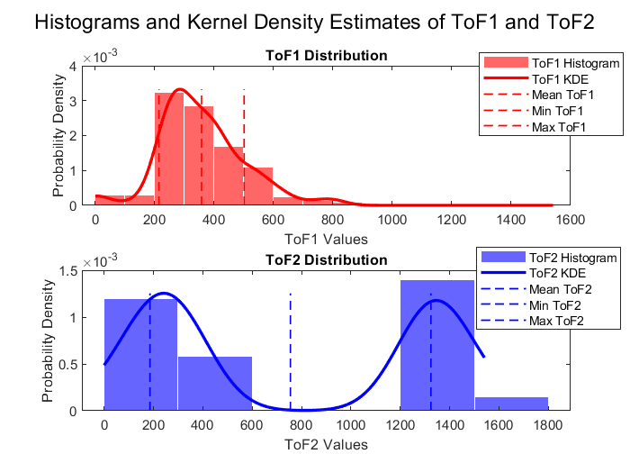
Minima Grid Creation Algorithm

Slide 7
Minimization Algorithms
GENETIC
ALGORITHM
Global optimization algorithm
5-times run for ~99% accuracy
FMINCON
Matlab optimization solver based on the gradient method
Data input from Genetic Algorithm
GRID SEARCH
Iterative procedure with three loop cycles
Data input from Genetic Algorithm

Slide 8
Minimization Algorithms
Results
 | Genetic Algorithm | Fmincon | Grid search
Total Cost ΔV | 19.1507 km/s | 19.1507 km/s | 19.1493 km/s
Total time | 1089.2607 days | 1089.2606 days | 1091.1495 days
Departure Date | 2039 January 23 19:35:19 | 2039 January 23 19:35:18 | 2039 January 23 18:51:41
Fly-By Date | 2040 April 13 15:39:55 | 2040 April 13 15:39:52 | 2040 April 13 16:38:06
Arrival Date | 2042 January 17 01:50:40 | 2042 January 17 01:50:37 | 2042 January 18 22:27:02

Slide 9
Final Trajectory Characterization
Heliocentric transfer orbits computed using the Lambert solver
 | a [km] | e [-] | i [deg] | Ω [deg] | ω [deg] | θ_{i} [deg] | θ_{f} [deg]
Lambert Arc 1 | 1.8284·10⁸ | 0.6522 | 6.7289 | 24.3818 | 297.5083 | 339.5508 | 242.7690
Lambert Arc 2 | 2.8954·10⁸ | 0.6970 | 9.4666 | 24.3818 | 270.7653 | 270.5814 | 189.9692
Incoming and outgoing hyperbolic trajectories
Hyperbola | a [km] | e [-] | v∞ [deg] | h_{p} [deg] | v_{p} [deg]
Incoming | -834.7118 | 8.8868 | 21.85248 | 212.2093 | 24.4668
Outgoing | -834.7096 | 8.8868 | 21.85256 | 212.2093 | 24.4669

Slide 10
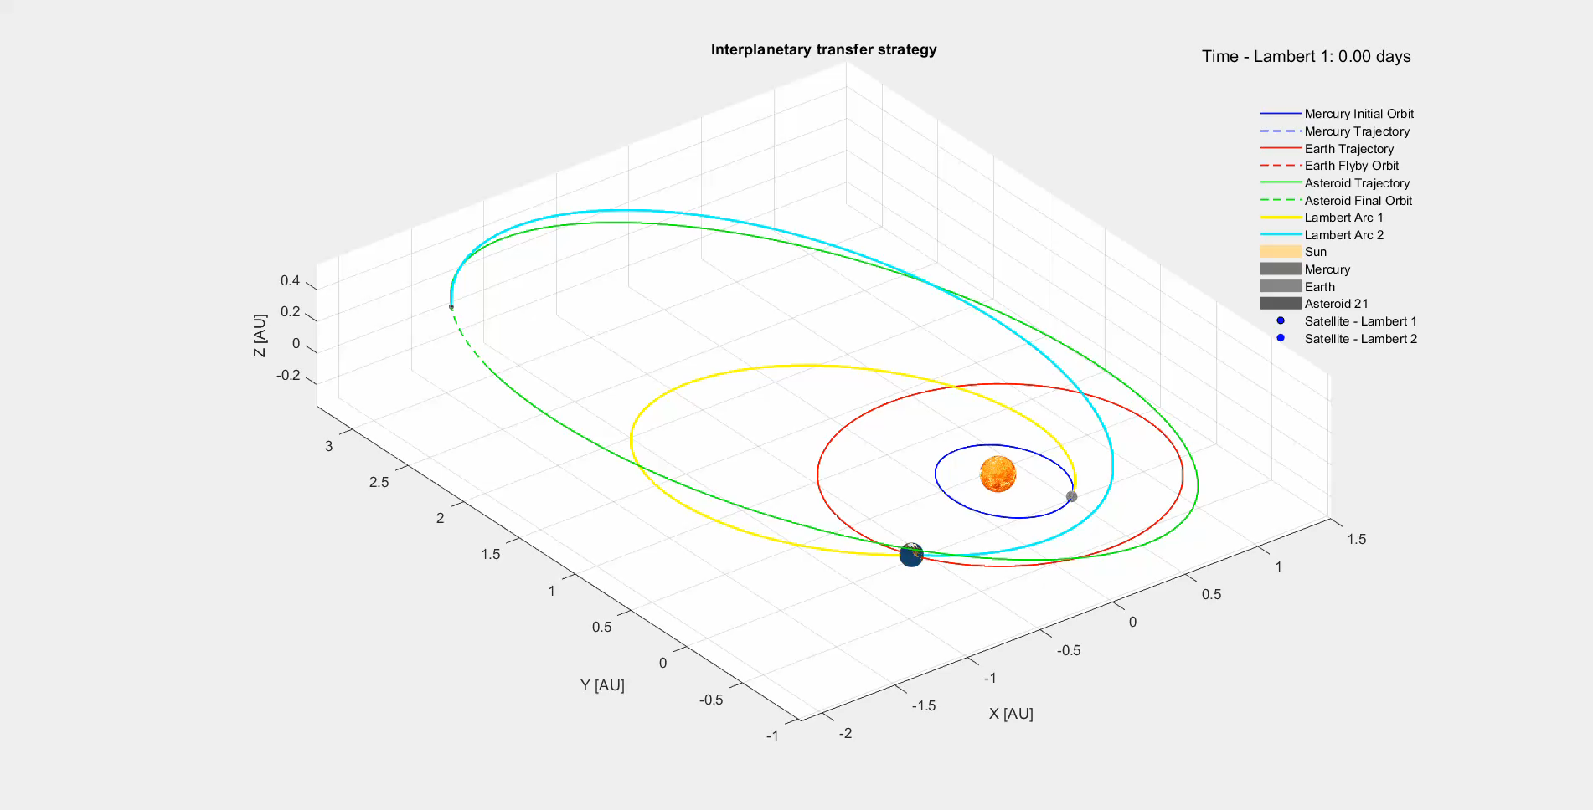
Transfer Strategy

Slide 11
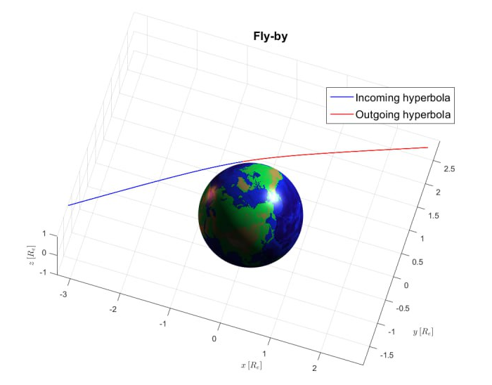
Fly-By

Slide 12
Final Results
Total Cost | 19.1493 km/s
Power Gravity Assist | 0.0000256 km/s
Departure Date | 2039 January 23 18:51:41
Fly-By Date | 2040 April 13 16:38:06
Arrival Date | 2042 January 18 22:27:02
ToF in the SOI | 23.4773 h

Slide 13
ASSIGNMENT 2
PLANETARY EXPLORER MISSION
Introduction
Orbit characterization
Ground Track
Repeating Ground Track
Orbit Propagation
Cartesian coordinates
Keplerian coordinates
Spectral frequency analysis
Comparison with real data

Slide 14
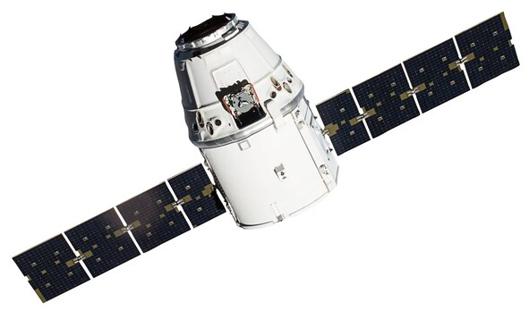
Analysis of the trajectory of a spacecraft
Different parameters
Cartesian Coordinates
Keplerian Elements
Different perturbations
Moon
Gravitational attraction
J2 Effect
Obtlateness of the Earth
Alterations:
Ω ω θ
Alterations:
i e ω
Geosynchronous satellite
Initial Keplerian Elements
a [km] | e [-] | i [deg] | Ω [deg] | ω [deg] | θ [deg]
42164 | 0.0007 | 0.1378 | 0 | 0 | 40

Slide 15
Workflow
Ground-Tracks
Projection of satellite’s orbit on Earth for both unperturbed and perturbed case
Orbit Propagation
State as function of position and velocity vectors (integration of Cartesian equations of motion)
State as function of Keplerian elements (integration of Gauss planetary equations)
Spectral Frequency Analysis
Filtering of the results through the movmean low-pass filter
Short-periodic oscillations: T
Comparison with real data
Long-periodic oscillations: 15T
SKYNET 1 (NORAD Catalogue ID: 4250)

Slide 16
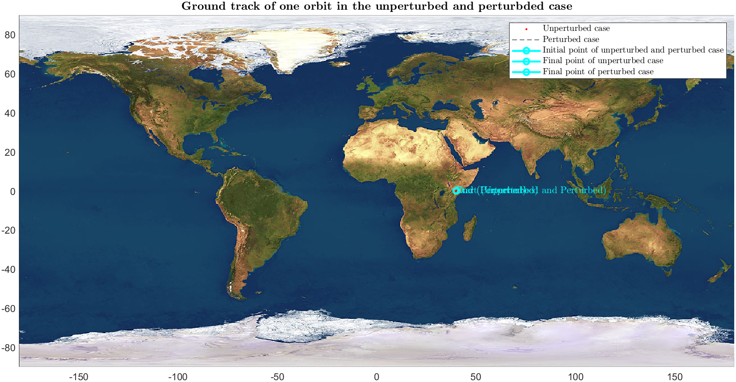
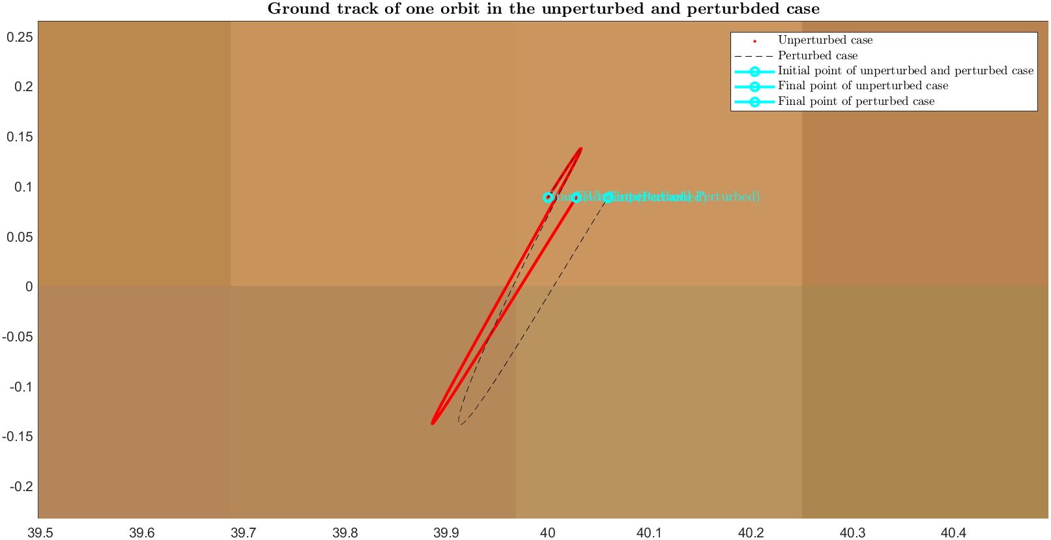
Ground Tracks: 1 Orbit

Slide 17
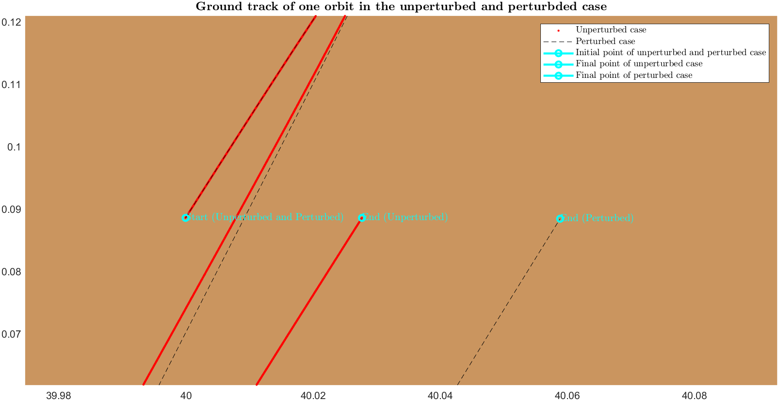
1 Orbit: Close-up

Slide 18

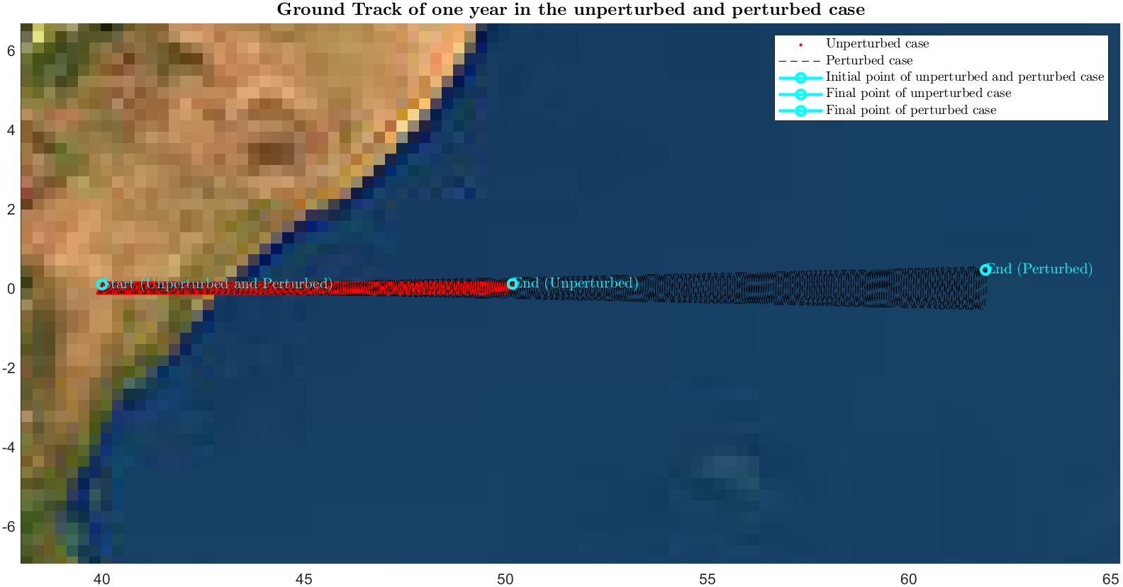
1 Year

Slide 19

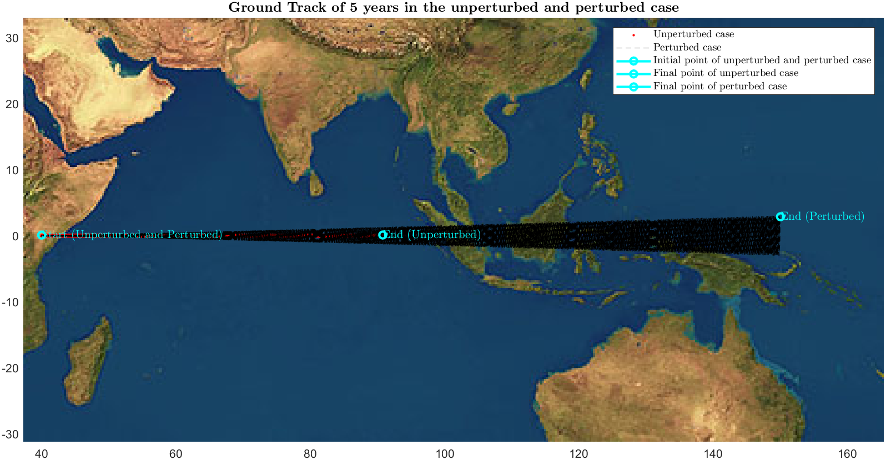
5 Years

Slide 20

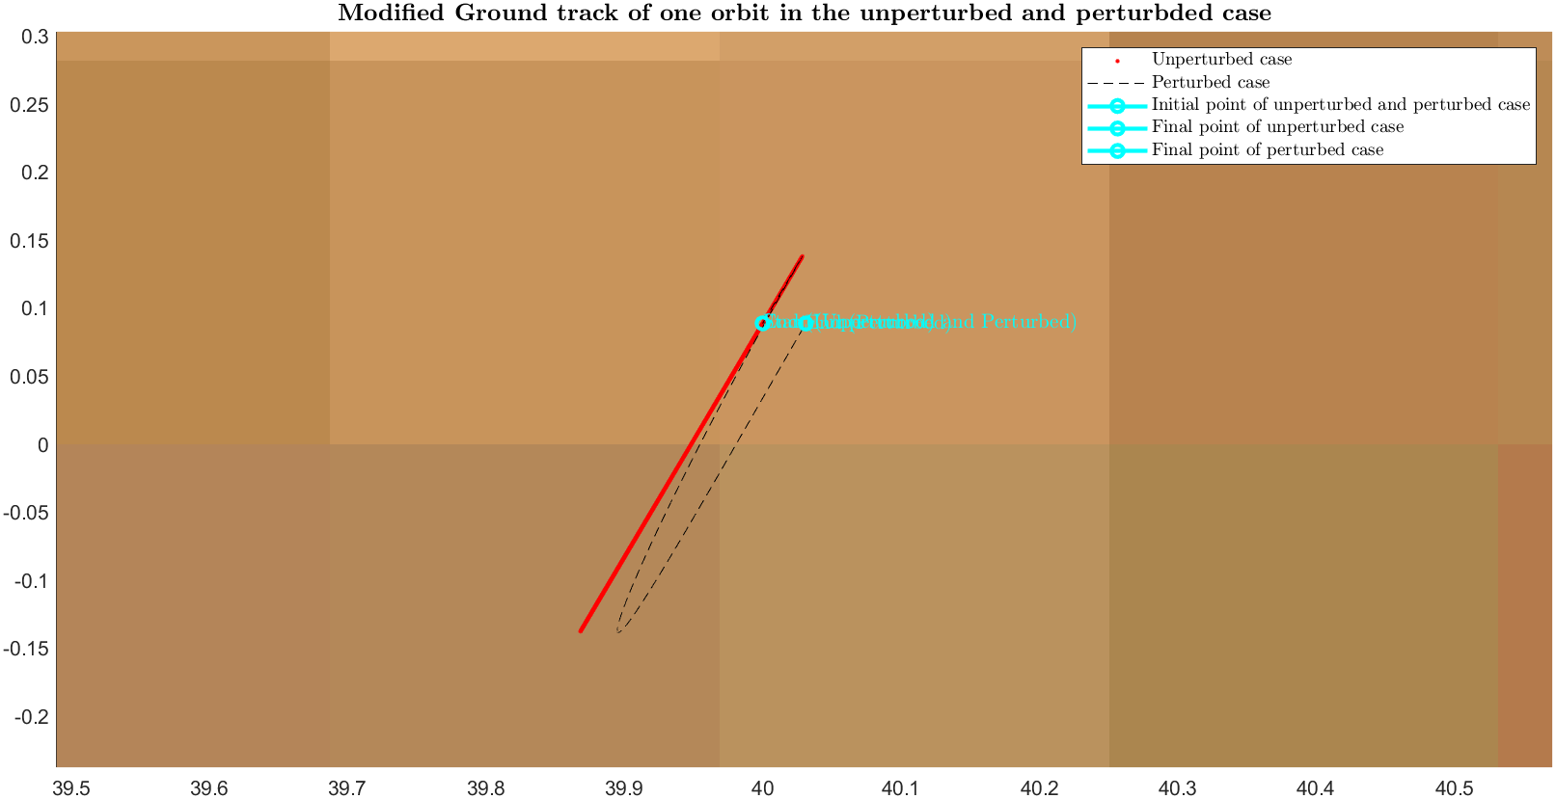
Repeating 1 Orbit

Slide 21
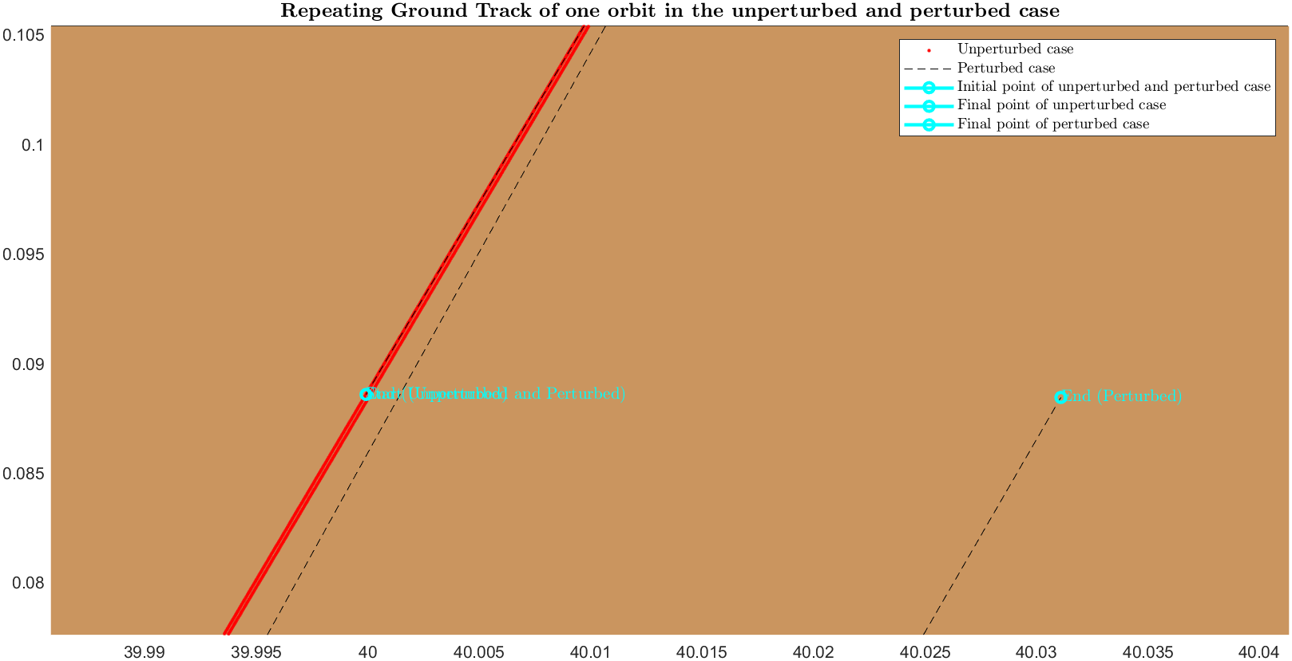
Repeating 1 Orbit: Close-up

Slide 22

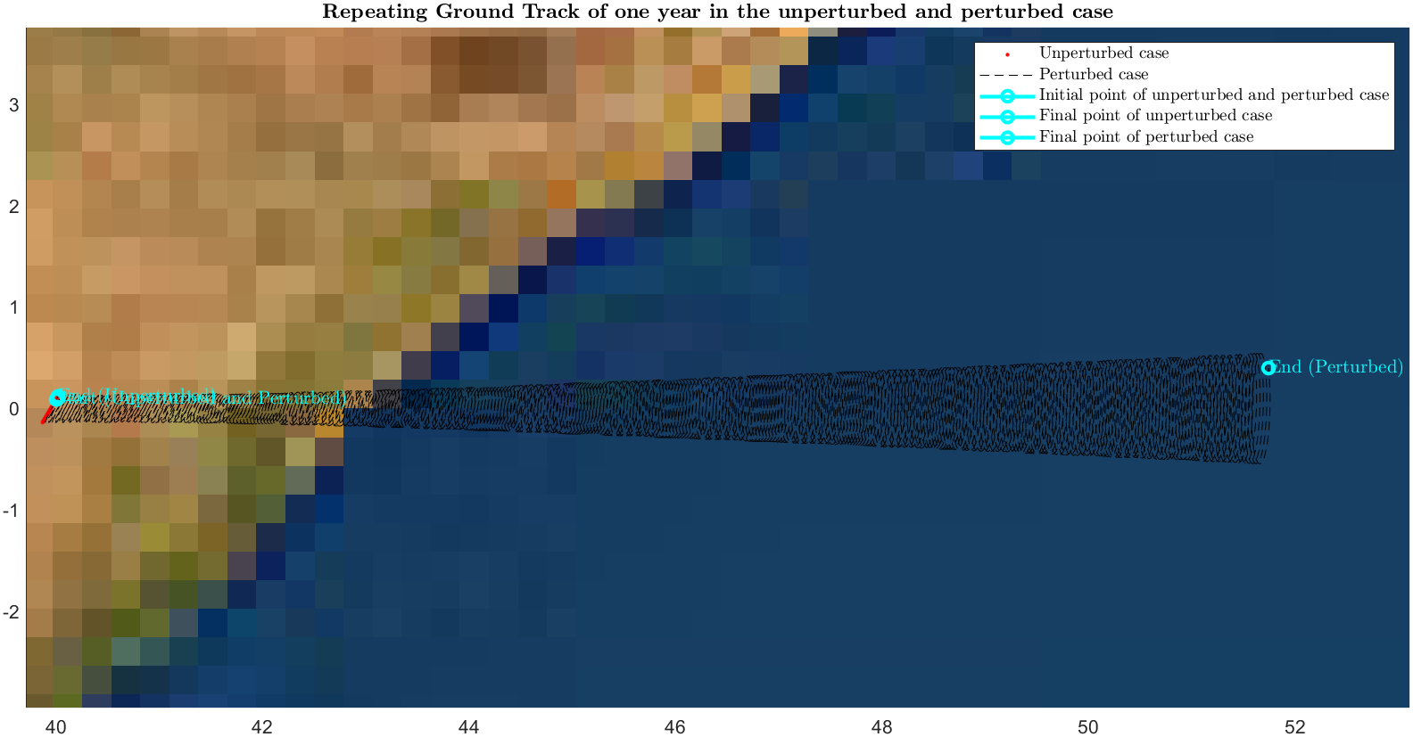
Repeating 1 Year

Slide 23

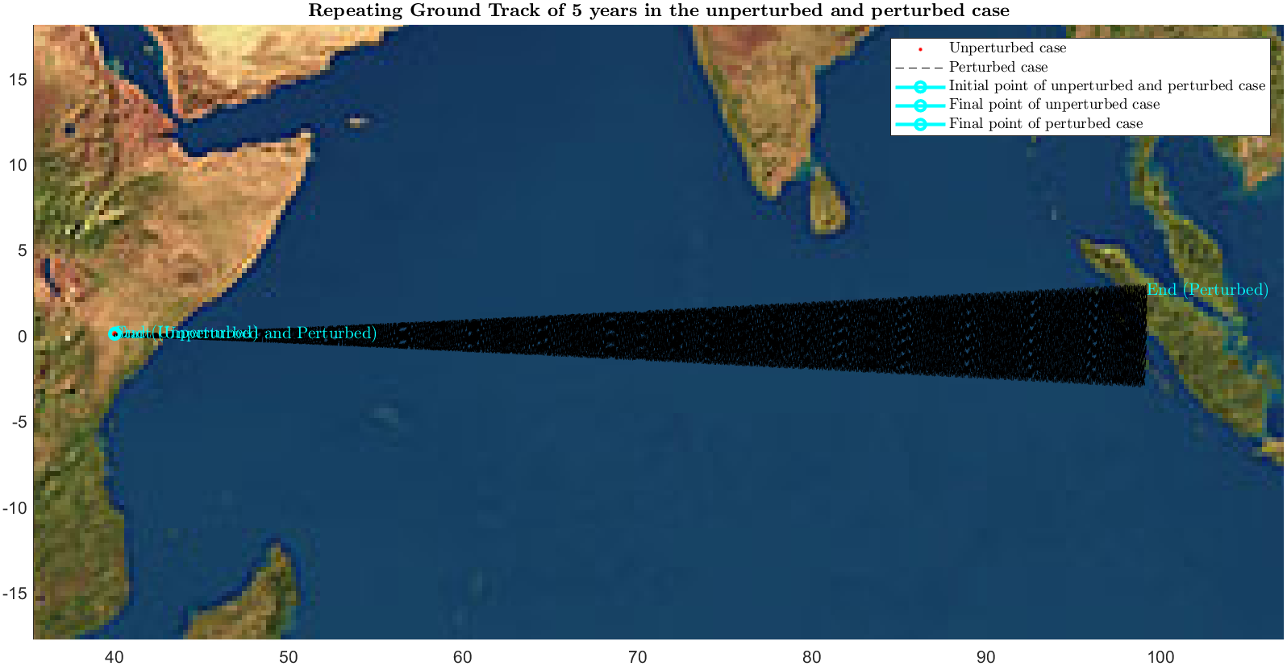
Repeating 5 Years

Slide 24
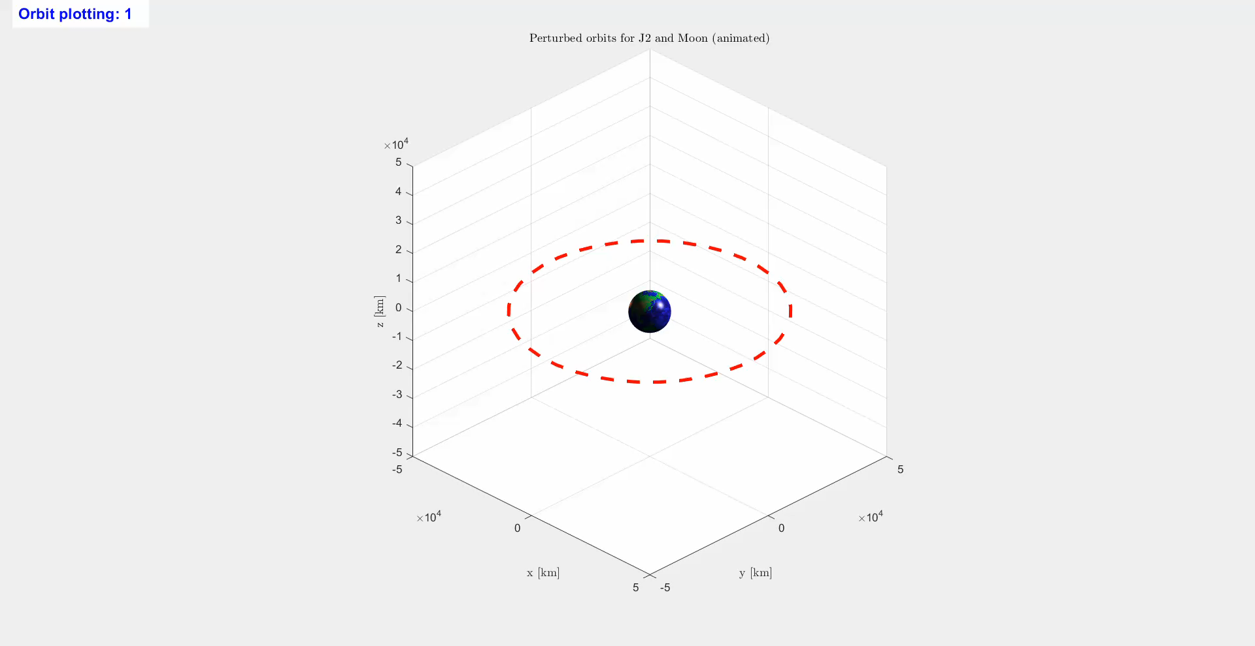
Orbit Propagation

Slide 25
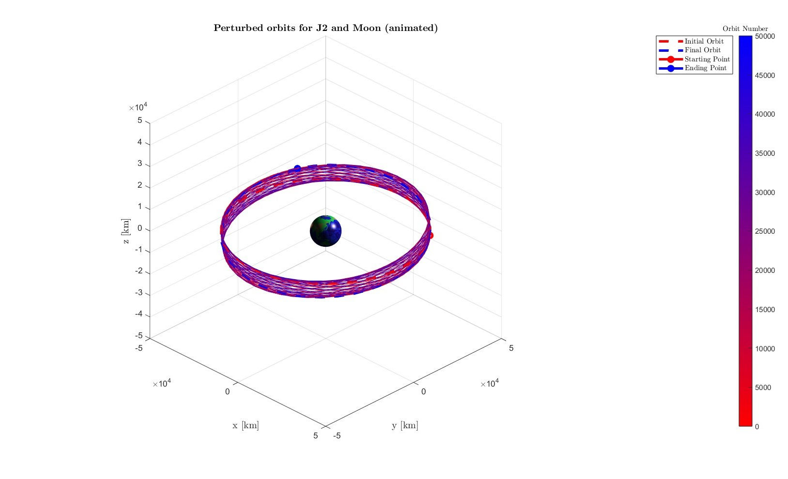
Orbit Propagation

Slide 26
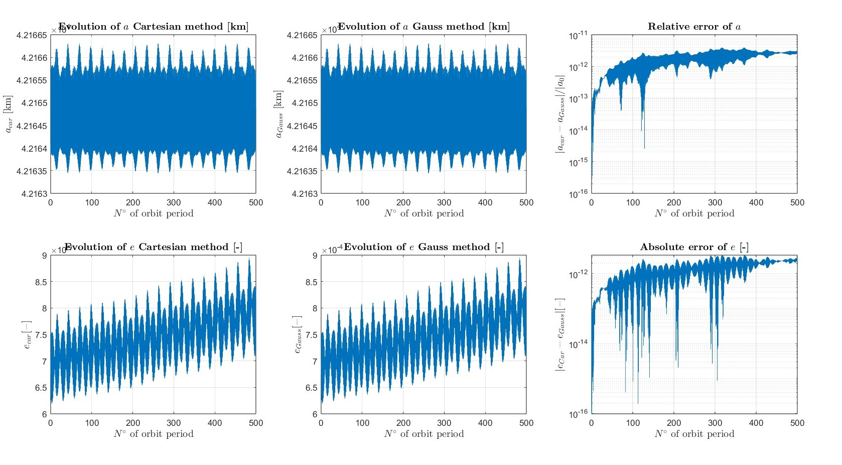
Cartesian and Keplerian Coordinates

Slide 27
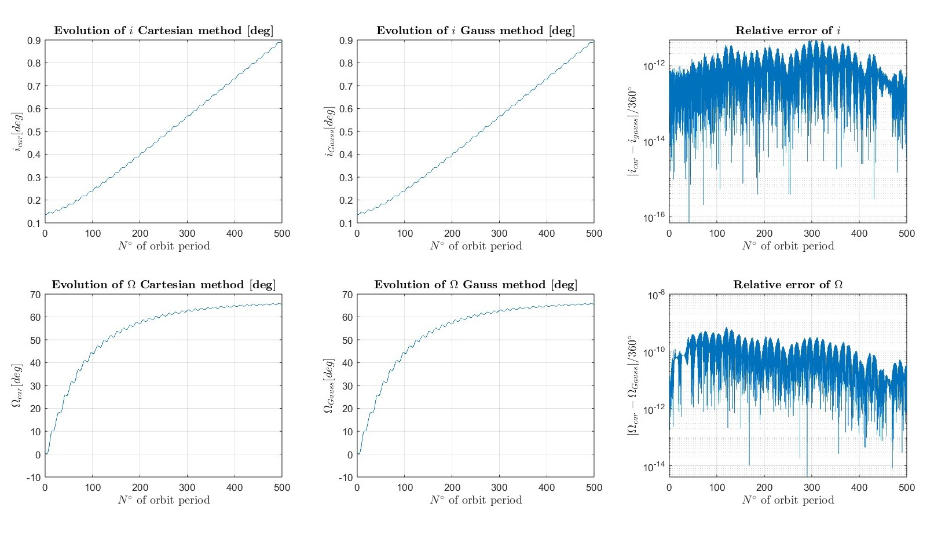
Cartesian and Keplerian Coordinates

Slide 28
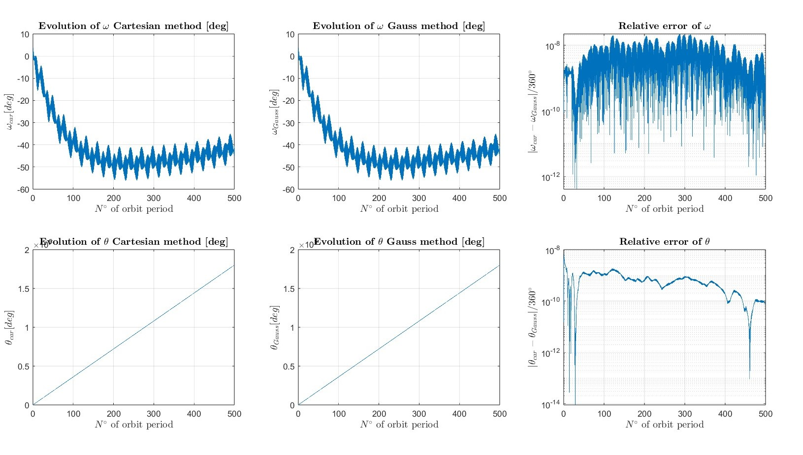
Cartesian and Keplerian Coordinates

Slide 29
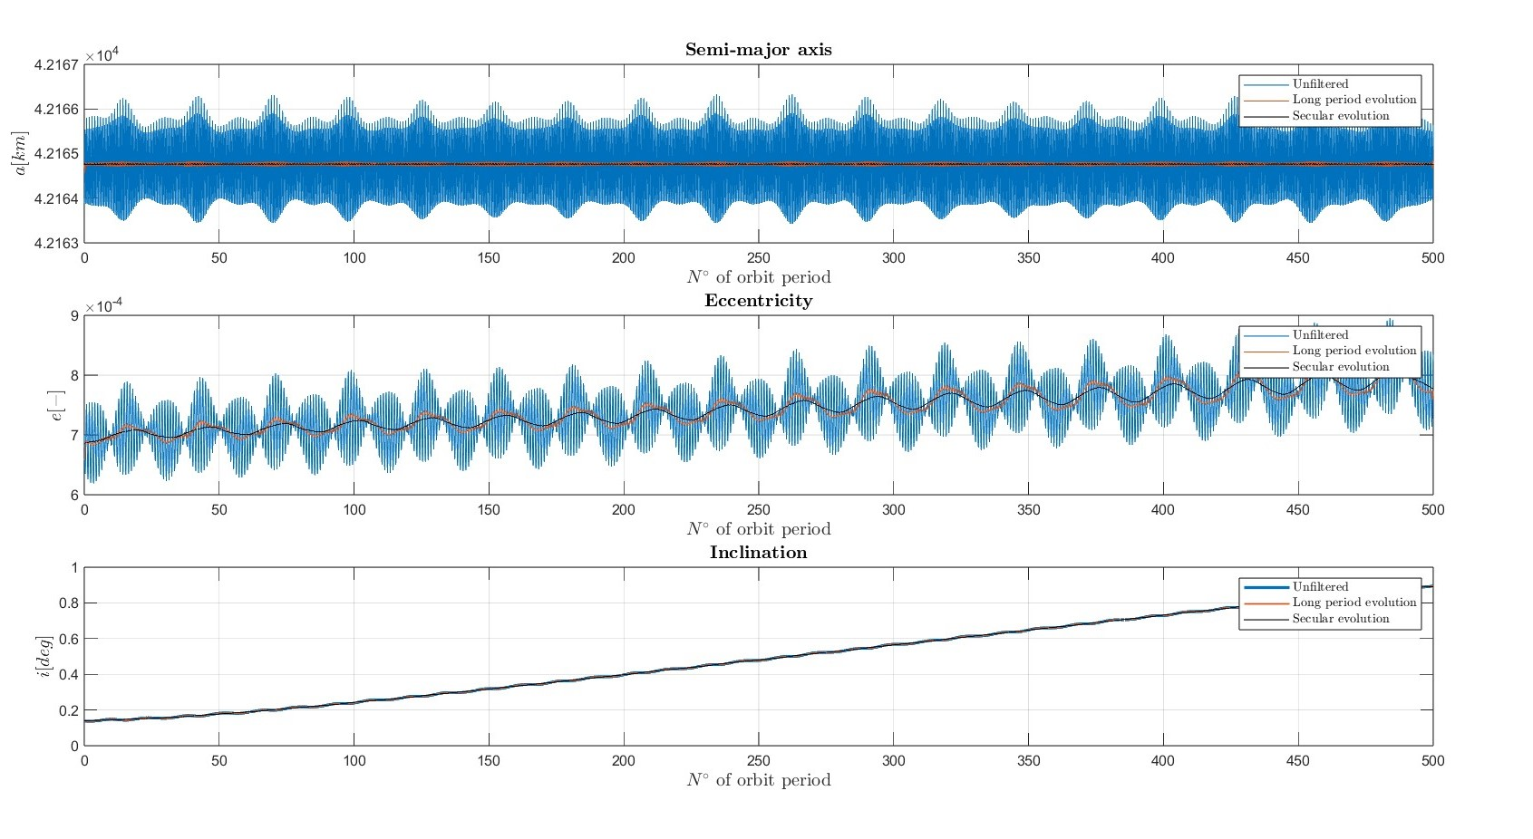
Spectral Frequency Analysis

Slide 30
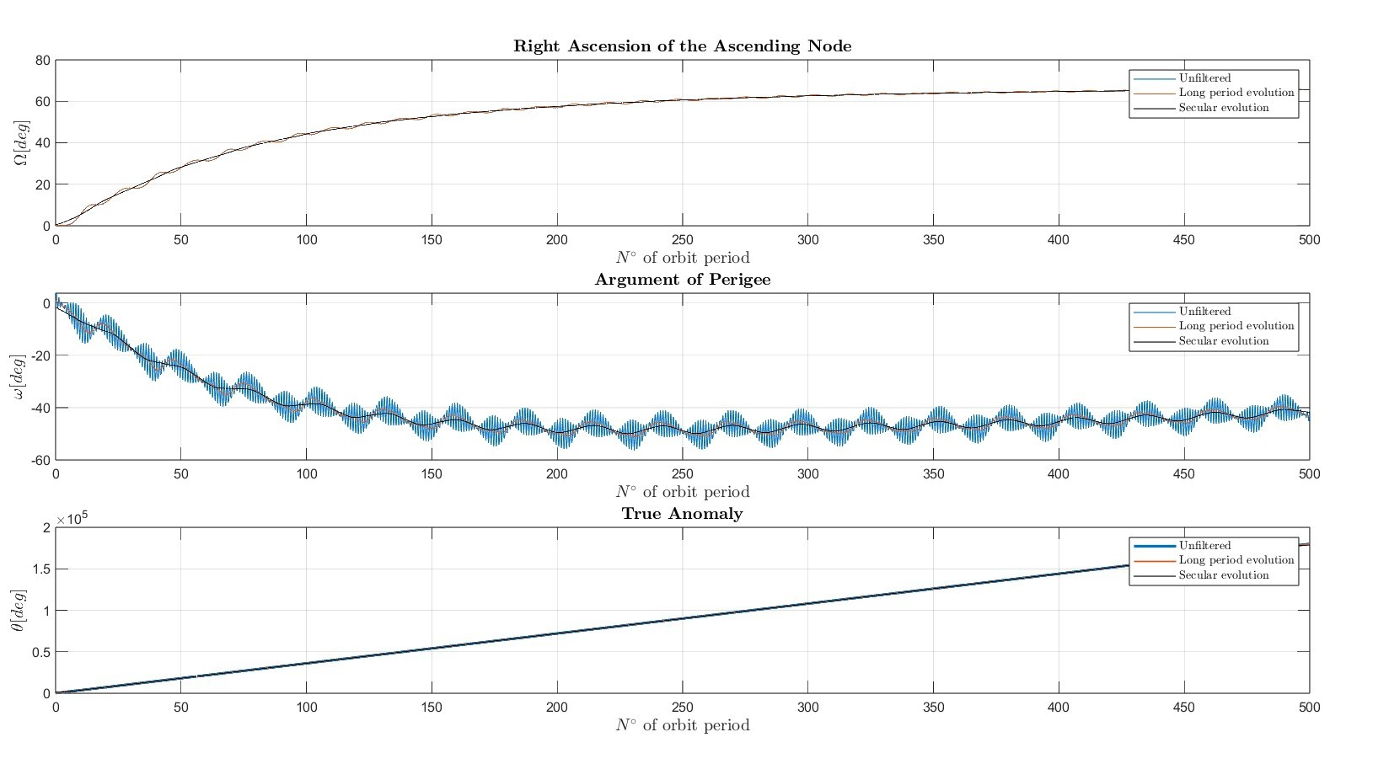
Spectral Frequency Analysis

Slide 31
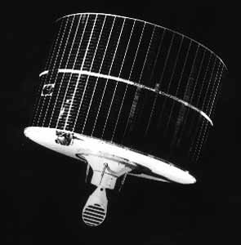
Comparison with real data: SKYNET 1
Orbital Elements
a [km] | e [-] | i [deg]
42164.86 | 0.00204689 | 0.2539839
Ω [deg] | ω [deg] | θ [deg]
6.21721876 | 1.08050218 | 6.13540754
Orbital period
T
86166.181662 s
Time propagation
Initial Date | Final Date
February 28th, 2000 | February 28th, 2002

Slide 32
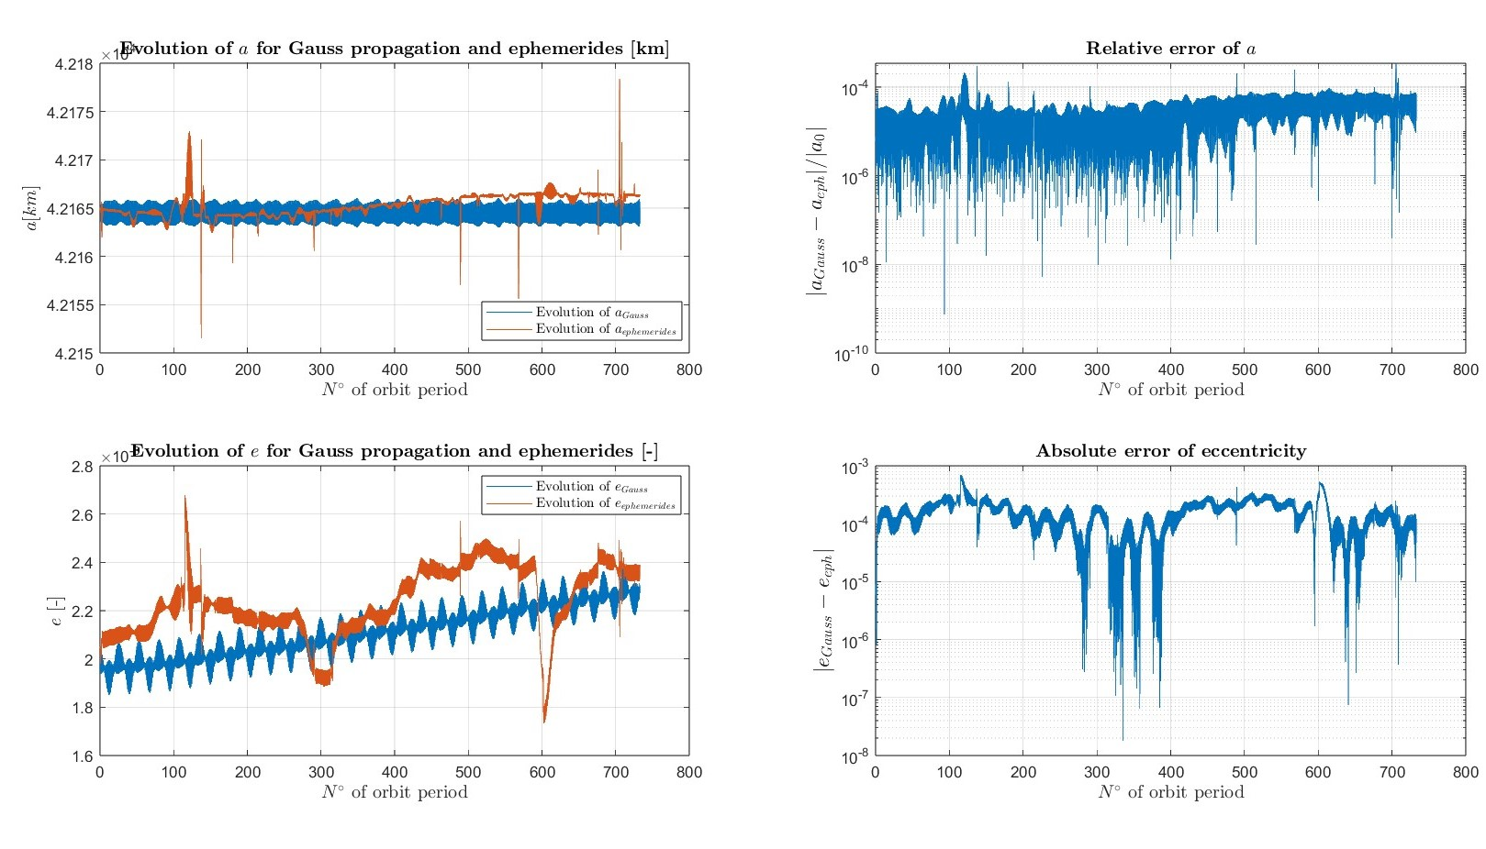
Comparison with real data: SKYNET 1

Slide 33
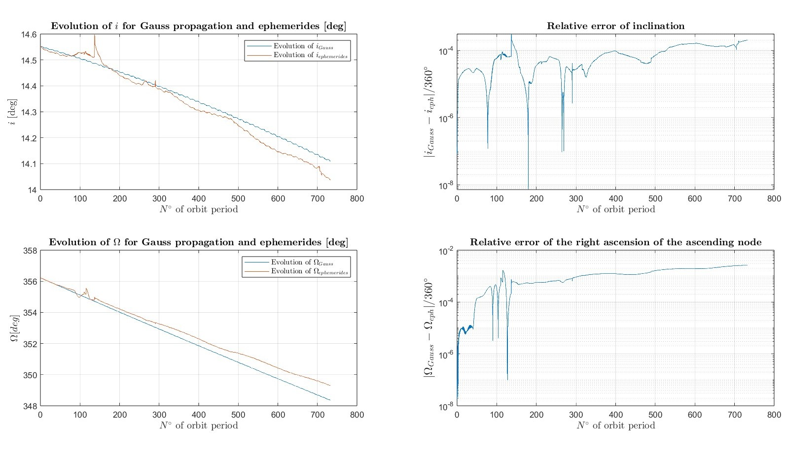
Comparison with real data: SKYNET 1

Slide 34
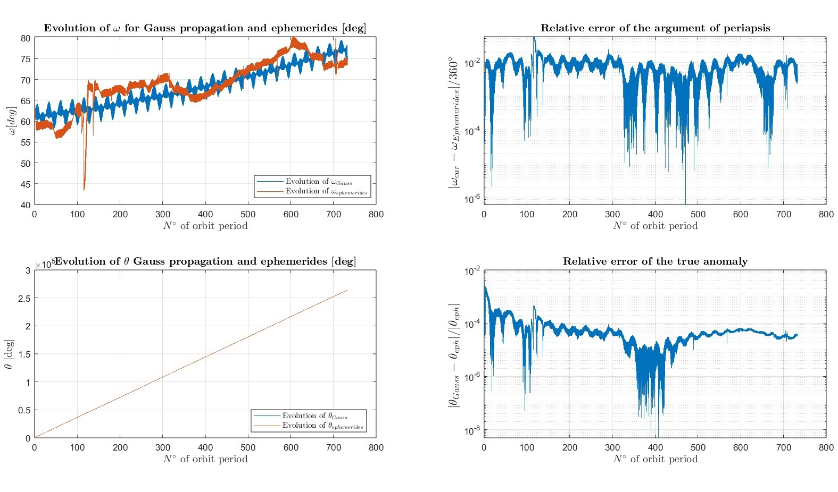
Comparison with real data: SKYNET 1

Slide 35
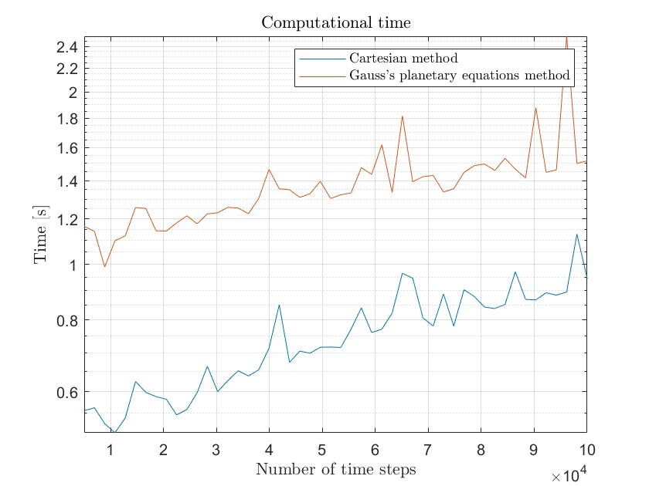
Results
Main observed perturbations:
Long-term oscillations repeating in a long time period (higher than spacecraft’s period)
Secular variations (non-periodic)
Propagation by means of Cartesian coordinates for the case analysed is more time efficient of 4.351076 s

Slide 36

Firma convenzione Politecnico di Milano e Veneranda Fabbrica del Duomo di Milano
Thank you for the attention.
Aula Magna – Rettorato
Mercoledì 27 maggio 2015

